Slide 1
Lecture 6

Slide 2
Use-Case for Returning Books
Actions performed by the actor | Responses from the system
1. The member arrives at the return counter with a set of books and gives the clerk the books.
2. The clerk issues a request to return books.
 | 3.The system asks for the identifier of the book.
4. The clerk enters the book identifier.
 | 5. If the identifier is valid, the system marks that the book has been returned and informs the clerk if there is a hold placed on the book; otherwise it notifies the clerk that the identifier is not valid. It then asks if the clerk wants to process the return of another book.
6. The clerk notes whether there is a hold on the book and answers in the affirmative or in the negative. If there is a hold, the clerk sets the book aside.
 | 7. If the answer is in the affirmative, the system goes to Step 3. Otherwise, it exits.

Slide 3
Use-Case for Removing Books
Actions performed by the actor | Responses from the system
1. Librarian identifies the books to be deleted.
2. The clerk issues a request to delete books.
 | 3. The system asks for the identifier of the book.
4. The clerk enters the ID for the book.
 | 5. The system informs the clerk about the success of the deletion operation. It then asks if the clerk wants to delete another book.
6. The clerk answers in the affirmative or in the negative.
 | 7. If the answer is in the affirmative, the system goes to Step 3. Otherwise, it exits.

Slide 4
Use-Case for Printing Transactions
Actions performed by the actor | Responses from the system
1. The clerk issues a request to get member transactions.
 | 2. The system asks for the user ID of the member and the date for which the transactions are needed.
3. The clerk enters the identity of the user and the date.
 | 4. If the ID is valid, the system outputs information about all transactions completed by the user on the given date. For each transaction, it shows the type of transaction (book borrowed, book returned or hold placed) and the title of the book.
5. Clerk prints out the transactions and hands them to the user.

Slide 5
Use-Case for Placing a Hold
Actions performed by the actor | Responses from the system
1. The clerk issues a request to place a hold.
 | 2. The system asks for the book's ID, the ID of the member, and the duration of the hold.
3. The clerk enters the identity of the user, the identity of the book, and the duration.
 | 4. The system checks that the user and book identifiers are valid and that the book is checked out. If yes, it records that the user has a hold on the book and displays that; otherwise, it outputs an appropriate error message.

Slide 6
Use-Case for Removing a Hold
Actions performed by the actor | Responses from the system
1. The clerk issues a request to remove a hold.
 | 2. The system asks for the book's ID and the ID of the member.
3. The clerk enters the identity of the user and the identity of the book.
 | 4. The system removes the hold that the user has on the book (if any such hold exists), prints a confirmation and exits.

Slide 7
Use-Case for Renewing Books
Actions performed by the actor | Responses from the system
1. Member makes a request to renew several of the books that he/she has currently checked out.
2. Clerk issues a request to renew books
 | 3. System asks for the member's ID.
4. The clerk enters the ID into the system.
 | 5. System checks the member's record to find out which books the member has checked out. If there are none, the system prints an appropriate message and exits; otherwise it displays the details of the first book checked to the member.
 | 6. System asks whether the book should be renewed.
7. The clerk replies yes or no.
 | 8. The system attempts to renew the book and reports the result. If there are no more renewable books, the system reports that and exits; otherwise the system displays information about the next book and goes to Step 6.

Slide 8
Use-Case for Processing Holds
Actions performed by the actor | Responses from the system
1. The clerk issues a request to process holds.
 | 2. The system asks for the book's ID.
3. The clerk enters the ID of the book.
 | 4. The system returns the name and phone number of the first member with an unexpired hold on the book. If all holds have expired, the system responds that there is no hold. The system then asks if there are any more books to be processed.
5. If there is no hold, the book is then shelved back to its designated location in the library. Otherwise, the clerk prints out the information, places it in the book and replies in the affirmative or negative.
 | 6. If the answer is yes, the system goes to Step 2; otherwise it exits.

Slide 9
Use Case Writing

Slide 10
Guidelines for Writing Use-Cases
Must be from the point of view of the actor in the active voice.
Must provide something of value to an actor/business.
Tells what the visible outcome is and does not give details of any other requirements that are being imposed on the system.
May change over the course of system analysis.
Should be functionally/temporally cohesive.
Each actor must be involved in at least one, and typically several use-cases.
Model is a set of use-cases.
Exceptional exit conditions are not handled in use-cases.

Slide 11
Use a set of rules that can be referred to from the use cases
Rule Number | Rules
1 | Due date for a book is one month from the date of issue
2 | All books are issuable
3 | A book is removable if it is not checked out and if it has no holds.
4 | A book is renewable if it has no holds on it.
5 | When a book with a hold is returned, the appropriate member will be notified.
6 | Holds can be placed only on books that are currently checked out.

Slide 12
Conceptual Class Diagram

Slide 13
Conceptual Classes and Relationships
Design Facilitation.
Added Knowledge.
Error Reduction.
Useful documentation.

Slide 14
Coming up with the Conceptual Classes
1) The customer fills out an application form containing the customer's name, address, and phone number and gives this to the clerk.
2) The clerk issues a request to add a new member.
3) The system asks for data about the new member.
4) The clerk enters the data into the system.
5) Reads in data, and if the member can be added, generates an identification number for the member and remembers information about the member. Informs the clerk if the member was added and outputs the member information that was stored.
6) The clerk gives the user his identification number.

Slide 15
Picking the Nouns
Customer
Application form
Customer's name
Address
Phone number
Clerk
Request
System
Data
Identification number
Member
User
Member Information

Slide 16
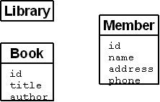
Conceptual Classes

Slide 17
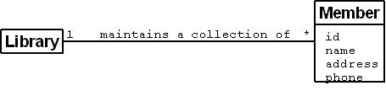
Associations

Slide 18
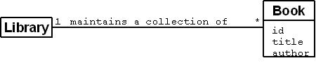
Associations

Slide 19
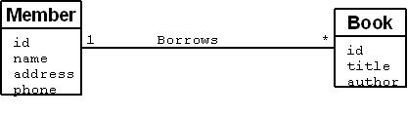
Associations

Slide 20

Associations

Slide 21
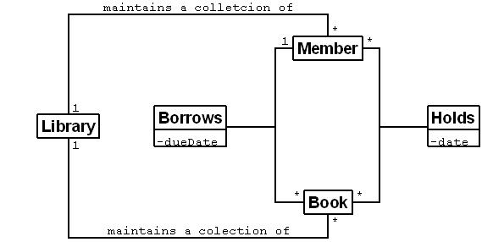
Conceptual Classes and their Associations

Slide 22
Domain Analysis

Slide 23
Domain Analysis
What is it:? process of analyzing related application systems in a domain so as to discover what features are common and variable between them.
How is it done?
First perform an exhaustive analysis of the class of applications in that domain.
Discover the business rules, the rules that any properly-functioning system in that domain must conform to.
Domain knowledge could be from surveys, existing applications, technical reports, user manuals, and so on.
What is the benefit? Reuse: the products (such as specifications, designs, code, test data, etc.) can be reused.

